Slide 1
Splay Trees

Slide 2
Splay Tree
Splay trees are tree structures that:
› Are not perfectly balanced all the time
› Data most recently accessed is near the root.
The procedure:
› After node X is accessed, perform “splaying”
operations to bring X to the root of the tree.
› Do this in a way that leaves the tree more balanced as a whole

Slide 3
Major operations in Splay Tree
Search (splay)
Insert
Delete

Slide 4
Search Operation
The search operation in Splay tree does the standard BST search, in addition to search, it also splays (move a node to the root). If the search is successful, then the node that is found is splayed and becomes the new root. Else the last node accessed prior to reaching the NULL is splayed and becomes the new root.

Slide 5
Search Operation
There are following cases for the node being accessed.
1) Node is root We simply return the root, don’t do anything else as the accessed node is already root.
2) Zig: Node is child of root (the node has no grandparent). Node is either a left child of root (we do a right rotation) or node is a right child of its parent (we do a left rotation).
T1, T2 and T3 are subtrees of the tree rooted with y (on left side) or x (on right side)

Slide 6
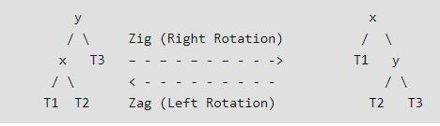
Search Operation

Slide 7
Search Operation
3) Node has both parent and grandparent.
There can be following subcases.
……..3.a) Zig-Zig and Zag-Zag Node is left child of parent and parent is also left child of grand parent (Two right rotations) OR node is right child of its parent and parent is also right child of grand parent (Two Left Rotations).

Slide 8
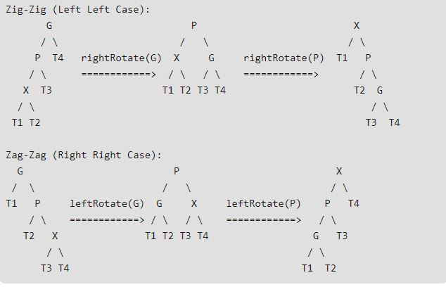
Search Operation

Slide 9
Search Operation
……..3.b) Zig-Zag and Zag-Zig Node is left child of parent and parent is right child of grand parent (Left Rotation followed by right rotation) OR node is right child of its parent and parent is left child of grand parent (Right Rotation followed by left rotation).

Slide 10
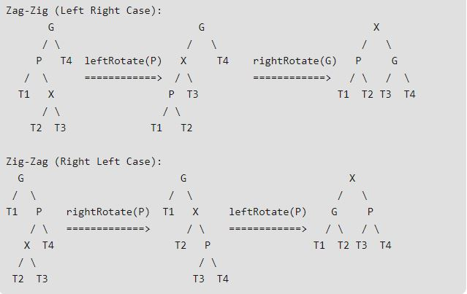
Search Operation

Slide 11
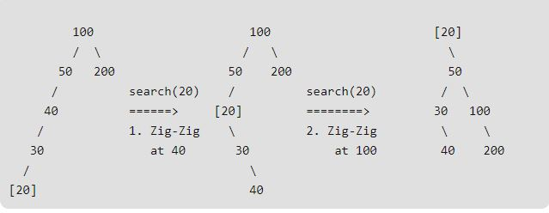
Example

Slide 12
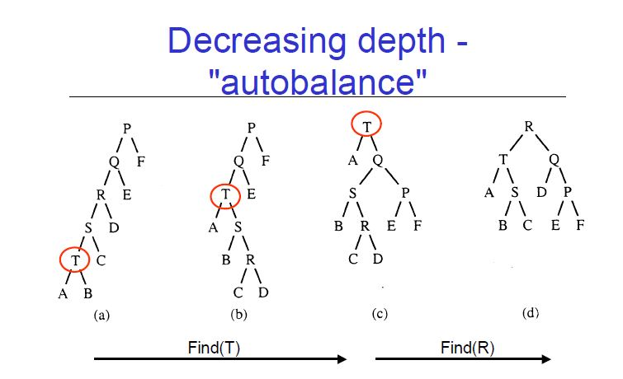
Another Example

Slide 13
Advantages
1) Splay trees have excellent locality properties. Frequently accessed items are easy to find. Infrequent items are out of way.
2) Splay trees are simpler compared to AVL as no extra field is required in every tree node.
3) Unlike AVL tree, a splay tree can change even with read-only operations like search.
4) All splay tree operations take O(logn) time on average.

Slide 14
Splay Tree: Insert and Delete
Insert x
› Insert x as normal then splay x to root.
Delete
› Splay x to root and remove it. Two trees remain, right subtree and left subtree.
› Splay the max in the left subtree to the root
› Attach the right subtree to the new root of the left subtree.

Slide 15
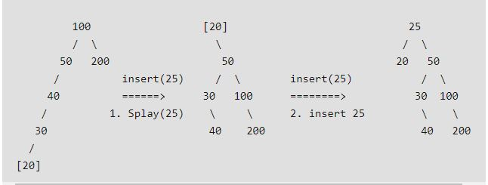
Example: Insertion

Slide 16
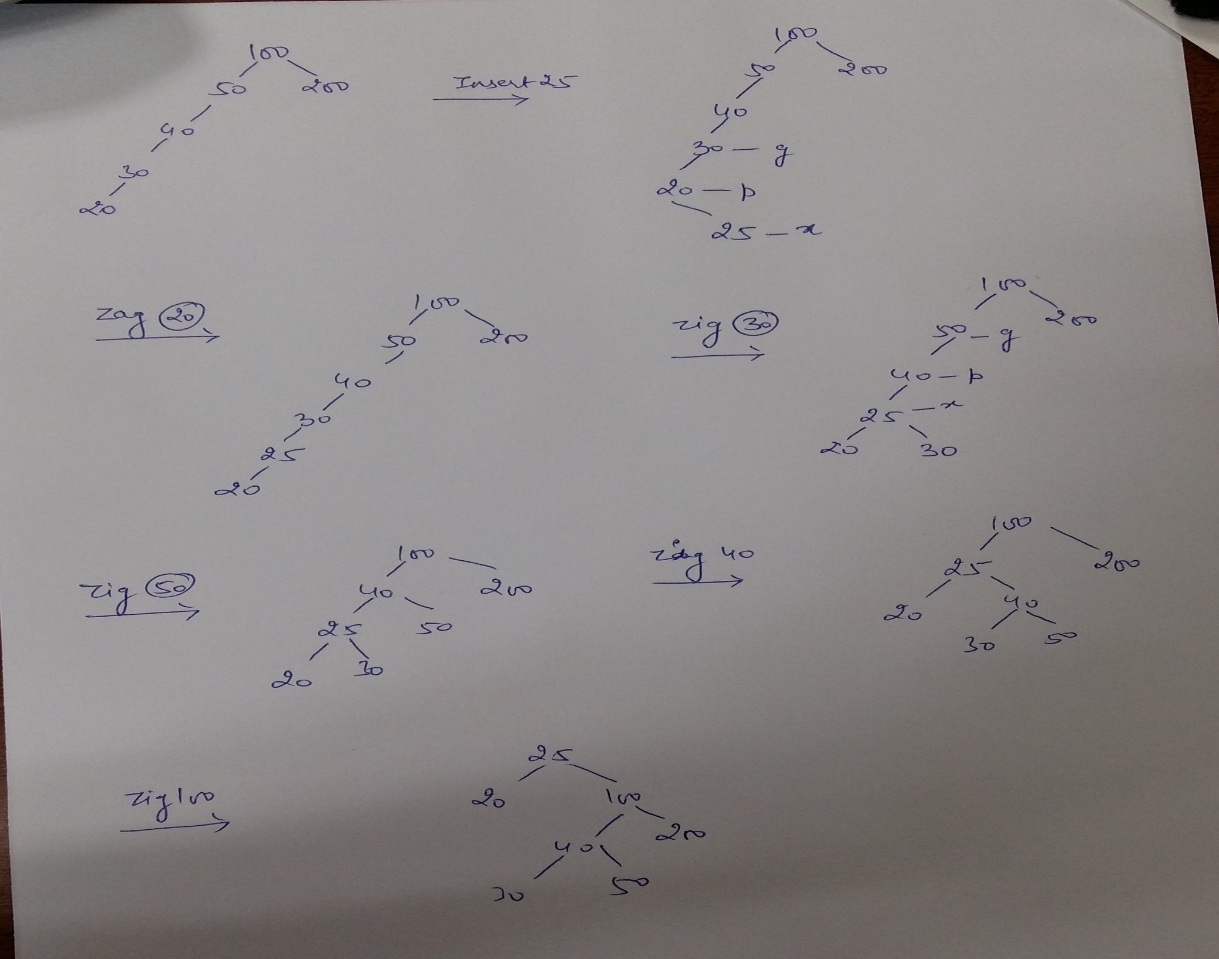

Slide 17
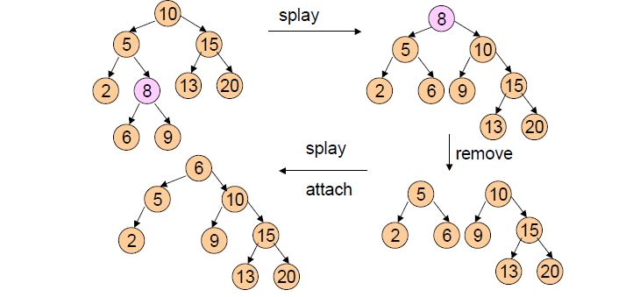
Example: Deletion

